Slide 1
SQL: what? why? And how?
Rachel Shorey with help from
Angie Brilliance, Pam Davis
and other Code for Progressers

Slide 2

How do you say it?
“S – Q – L”
“Sequel”

Slide 3
What is it?
Structured Query Language
From Wikipedia: “a special-purpose programming language designed for managing data held in a relational database management system”

Slide 4
RDBMS?
A Relational Database stores data

Slide 5








RDBMS?
A Relational Database stores data

Slide 6
RDBMS?
A Relational Database stores data AND relationships
sister
mayor
neighbor
mayor
father
mother
mayor
it’s complicated
sister
father
teacher
father

Slide 7

Why not just use Excel?

Slide 8
Database to the rescue!
Use queries to create, view, alter, combine and delete database tables
You can’t always see all your data at once…but you’ll get used to it!
More consistent: you don’t have to worry about the range of your formula if you add data, copying all the way down, etc.

Slide 9
Who makes SQL?
SQL is a standard, theoretical language
Implementations allow you to use it
Postgres
MySQL
SQL Server
Etc
Most features are common
If you learn the standard, you’ll have to make minor changes for each implementation

Slide 10
Data
Relational databases: data in tables
Tables are made up of records
Each record has values for every field (or column)
Tables usually have a unique ID called a primary key
This ID can be used to refer to a record from another table as a foreign key

Slide 11

VRA Dataset
Two minutes on the Voting Rights Act

Slide 12
break;
Up front - SELECT statements from scratch
Others groups - JOINs, Aggregate functions, etc. (or split off now if you already have a SQL implementation installed and can load data)
Note: if you have a sql implementation installed, know how to load data, and want to work with that, there are CSV files. Otherwise, we’ll use sqlfiddle.com together

Slide 13
Dataset
If you know how to acquire it from github, do it: https://github.com/rshorey/vr-sample-data
There are CSVs with data, sample questions, and load statements that work in MySQL (READ COMMENTS AND FOLLOW INSTRUCTIONS THOUGH)
If you don’t have a github account, you should still be able to pull a zipfile from the git site

Slide 14
Sqlfiddle.com
Go there
Open the file sqlfiddle_schema.sql from github or the zip I sent you in a text editor
Copy everything
Paste it in the box on the left side
Click build schema

Slide 15
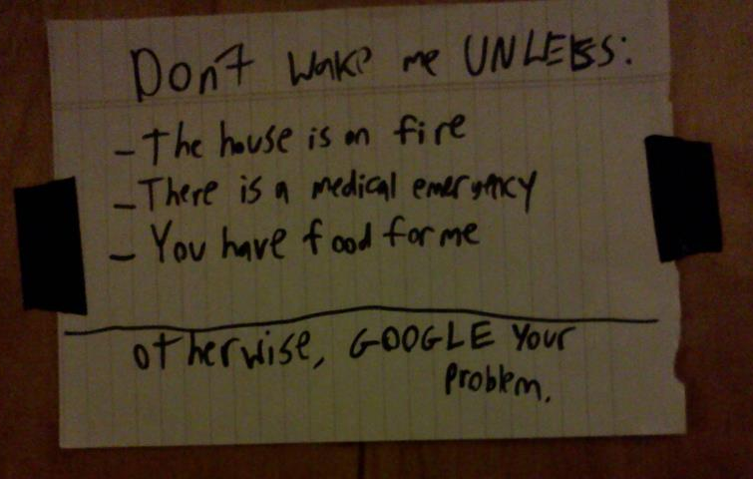
How to remember it all?
Don’t. Real programmers google. All the time.

Slide 16
What is SELECT?
SELECT allows you to view and manipulate data in your database tables
The workhorse of SQL

Slide 17

Anatomy of a SELECT
SELECT [columns] FROM [table];

Slide 18
Anatomy of a SELECT
SELECT [columns] FROM [table];
Example:
Display the section and description for each section of the VRA

Slide 19
Anatomy of a SELECT
SELECT [columns] FROM [table];
Example:
Display the section and description for each section of the VRA
SELECT section, description FROM sections;

Slide 20

A star is born!
If you want to see all your data, listing all the columns is a pain!
The wildcard character * will do it for you!

Slide 21
A star is born!
If you want to see all your data, listing all the columns is a pain!
The wildcard character * will do it for you!
Show all columns from the States table

Slide 22
A star is born!
If you want to see all your data, listing all the columns is a pain!
The wildcard character * will do it for you!
Show all columns from the States table
SELECT * FROM states;

Slide 23
“Columns” can be exciting!
You can do math when you specify the columns!

Slide 24
“Columns” can be exciting!
You can do math when you specify the columns!
Find the state name and the number of Hawaiians in each state

Slide 25
“Columns” can be exciting!
You can do math when you specify the columns!
Find the state name and the number of Hawaiians in each state
SELECT name,
(pct_hpi*population)/100 as num_hpi
FROM states;

Slide 26
“Columns” can be exciting!
You can do math when you specify the columns!
Find the state name and the number of Hawaiians in each state
SELECT name,
(pct_hpi*population)/100 as num_hpi
FROM states;

Slide 27

Explore!
Introduce yourself to the person next to you
Poke around the dataset together and get to know it
Ask questions!

Slide 28

Too much data!
Maybe you don’t want to see all of your data!
Lots of options can be added to the most basic SELECT statement.

Slide 29
Too much data!
Maybe you don’t want to see all of your data!
Lots of options can be added to the most basic SELECT statement.
LIMIT: only retrieves the specified number of records
WHERE: only retrieves records meeting a condition

Slide 30
Too much data!
Preview the Cities table by showing 10 rows

Slide 31
Too much data!
Preview the Cities table by showing 10 rows
SELECT * FROM cities
LIMIT 10;

Slide 32
Too much data!
Show the names of only states in the south

Slide 33
Too much data!
Show the names of only states in the south
SELECT name FROM states
WHERE region = ‘s’;
This data was all stolen from wikipedia. IT IS NOT MY FAULT THAT THEY THINK DC IS IN THE SOUTH! Do not complain to me. Complain to the cloud.

Slide 34
Summarize my data!
Get topline stats on the whole dataset
Examples: counts, sums, averages
These will return ONE row with the count/sum/average/whatever

Slide 35
Summarize my data!
How many cities are in the Cities table?

Slide 36
Summarize my data!
How many cities are in the Cities table?
SELECT COUNT(name) FROM cities;

Slide 37
Summarize my data!
What is the average state population?

Slide 38
Summarize my data!
What is the average state population?
SELECT AVG(population) FROM states;

Slide 39
Summarize and filter!
WHERE and aggregate functions can be combined!

Slide 40
Summarize and filter!
WHERE and aggregate functions can be combined!
Find the total total population of that are at least 15% black

Slide 41
Summarize and filter!
WHERE and aggregate functions can be combined!
Find the total total population of states that are at least 15% black
SELECT SUM(population) FROM states
WHERE pct_black >= 15;

Slide 42

Explore some more!
Try returning some summary stats.
Try returning fewer rows with LIMITs and WHEREs
Ask questions!
If you need inspiration, check out the sample questions that came with the data

Slide 43
Aggregating with categories
We can find the total population for the “South” region of the US:
SELECT SUM(population)
FROM states
WHERE region = ‘s’;

Slide 44
Aggregating with categories
What if we want to know the population for each region?
SELECT SUM(population) FROM states
WHERE region = ‘s’;
SELECT SUM(population) FROM states
WHERE region = ‘n’;
…

Slide 45
Aggregating with categories
What if we want to know the population for each region?
Do it all at once!
SELECT region, SUM(population)
FROM states
GROUP BY region;

Slide 46
GROUP BY: how it works
Break the data into categories based on the GROUP BY field
Perform aggregate functions separately on each group

Slide 47
Where we’ve come so far
SELECT [columns]
FROM [table]
WHERE [condition]
GROUP BY [columns]
LIMIT [number];

Slide 48
One simple addition
SELECT [columns]
FROM [table]
WHERE [condition]
GROUP BY [columns]
ORDER BY [columns] [order]
LIMIT [number];

Slide 49
Keep Exploring!
Use GROUP BY to get summary stats for multiple categories
Use ORDER BY to sort the results
Combine GROUP BY and WHERE!
Ask questions
If you need inspiration, check out the sample questions that came with the data

Slide 50
What’s next?
So far, we’ve been working with single tables
But we’ve got a dataset with four tables and connections among them
SQL lets you combine tables for richer analysis (not unlike VLOOKUP in excel, but easier and more powerful!)
Google it: SQL JOINs

Slide 51
Resources
Dataset: https://github.com/rshorey/vr-sample-data
SQL Fiddle: http://sqlfiddle.com/
Good interactive SQL tutorial: http://www.w3schools.com/sql/

Slide 52
Cities? States? Sections?
We’ve got multiple tables
How do we analyze data that lives across multiple tables?
The keyword in SQL: JOIN
Idea is similar to an excel VLOOKUP, but much more powerful

Slide 53
Some JOIN theory
JOINS look in two tables
And find records that match
Based on criteria you provide
States
id | name
5 | California
33 | New York
14 | Illinois
Cities
Name | State_id
New York | 33
Los Angeles | 5
Chicago | 14
San Francisco | 5

Slide 54
JOIN syntax
SELECT cities.name as city_name,
states.name as state_name
FROM cities
JOIN states
ON cities.state_id = states.id;
You need to specify which table each column comes from now, because you’re asking for things from multiple tables

Slide 55
JOIN syntax
SELECT cities.name as city_name,
states.name as state_name
FROM cities
JOIN states
ON cities.state_id = states.id;
Select statement, like we’re used to, with table names and aliases

Slide 56
JOIN syntax
SELECT cities.name as city_name,
states.name as state_name
FROM cities
JOIN states
ON cities.state_id = states.id;
This part of the FROM should look familiar

Slide 57
JOIN syntax
SELECT cities.name as city_name,
states.name as state_name
FROM cities
JOIN states
ON cities.state_id = states.id;
Now we’re telling SQL to add in another table

Slide 58
JOIN syntax
SELECT cities.name as city_name,
states.name as state_name
FROM cities
JOIN states
ON cities.state_id = states.id;
Telling SQL how to decide whether a cities record matches a states record

Slide 59
Different kinds of joins
Outside of the scope of this lesson
BUT, you should know they exist
And we’re learning INNER JOINS, which only return a record if both tables match
JOIN (in most SQL implementations) defaults to INNER JOIN

Slide 60
JOINS: as many tables as you want
SELECT cities.name as city_name,
states.name as state_name
FROM cities
JOIN states
ON cities.state_id = states.id;
Internally, SQL creates a temporary table from the red part of this statement

Slide 61
JOINS: as many tables as you want
SELECT cities.name, sections.section
FROM cities
JOIN states
ON cities.state_id = states.id
JOIN sections_states
ON states.id = sections_states.state_id
JOIN sections
ON sections.id = sections_states.section_id;
Which section of the VRA applies to which cities?

Slide 62
JOINS plus other commands
Joins can be combined with any other command
WHERE, LIMIT, ORDER BY, aggregate functions, GROUP BY …

Slide 63
JOINS plus other commands
SELECT states.name, COUNT(cities.name)
FROM cities
JOIN states
ON cities.state_id = states.id
WHERE states.region = 'w'
GROUP BY states.name
ORDER BY states.population DESC;
Finds the number of cities in our DB in each state in the west and orders results by state population

